Slide 1
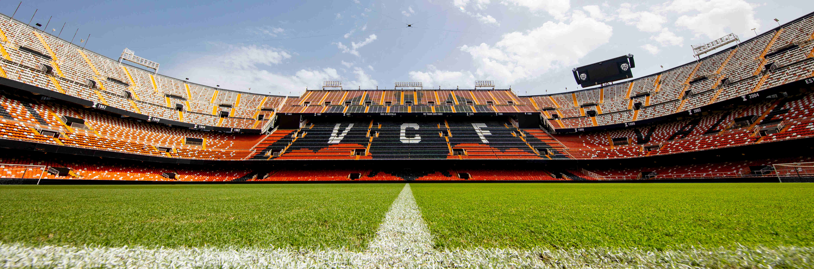
Head Coach Retention Decision & Overall Team Performance Improvements - Valencia C.F
Group 2D: Daniel Arnold, Salva Ribera Palacios, Luis Rosado, Bharath Yadav Golla

Slide 2

Overview
Goal: To decide whether or not to retain the head coach​ and added a bonus to the organization – overall team improvements​
Techniques: Multiple linear regression analysis, logistic regression analysis, & time series analysis
Problems: Data sources, formatting & cleaning data, answering the actual boolean question about the coach.

Slide 3

Background oF Valencia C.F​
One of the most renowned soccer teams in Spain, known for its rich history and success. Historically, it was a strong contender in La Liga, often ranking high in the league standings​
Purchased by Singaporean businessman Peter Lim in 2014 for approximately €94 million.​
Since being acquired:​
Criticized for a lack of transparency and effective leadership under its manager, president, and directors, leading to discontent among supporters and frustration over inconsistent results & tactics.​
Valencia CF has experienced a notably high turnover of managers in recent years, reflecting ongoing instability within the club and inconsistency in the team's performance​
Currently, in the 2024/2025 season, the club is facing relegation, enduring one of its worst starts in recent history.

Slide 4
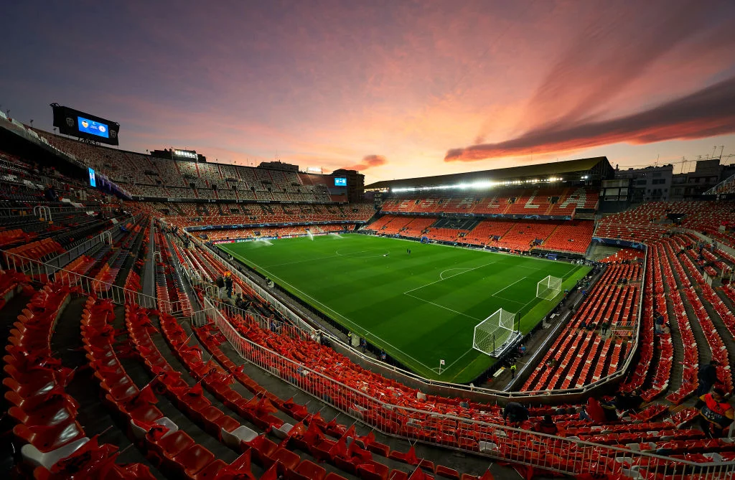
Current Status and Analysis​
President Lay Hoon Chan - stated he believes in and invests in the use of data for decision-making that generates more value for fans.​
Partnered with a third-party analytics company, Blinkfire Analytics, to better leverage data insights.​
Commercial & sports analysis used to examine player performance, determine ticket prices, and improve the visitor experience of its physical & online stores​
No specific indication of an internal dedicated business analytics team or specific tools used​
Valencia CF's analytical maturity appears to be in the Diagnostic Analytics stage with aspirations for Predictive Analytics
Notes:
Most of the information regarding the organizations data usage is with the president's usage of terms such as "we plan on doing" or "we will do something." This indicates a low level of analytical maturity throughout the organization. Due to this low level of maturity it is evident the organization seeks to outsource this job to the experts until such time that it can provide the services in house at a reasonable level.

Slide 5
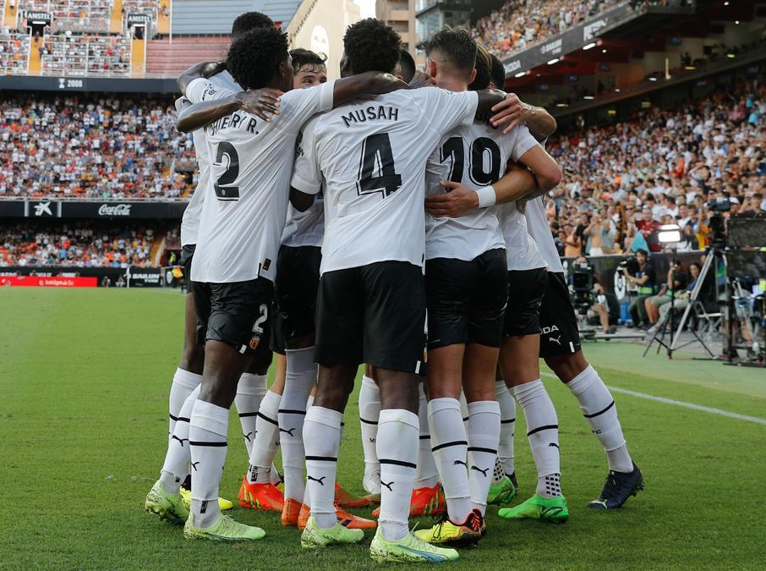
The business analytics problem
The main issue that Valencia CF is facing is that they ended the season in 9th place and did not qualify for any European soccer tournament i.e. Europa league or Champions League. ​
When the club does not win, they do not receive more advertising money and bonuses from the league, thus they cannot grow.​
No sophisticated organizational process of using data analytics to make informed decisions. Team requires a third party firm to bring this expertise.​
The person usually blamed or praised when the club is in decline or achieves greatness, the Manager. ​
The current manager has been with the team since February of 2023. Is this enough time for a manager’s campaign to make a difference? Are there other factors that influence success that are out of the manager’s control?
Notes:
In analyzing a football club’s success there are many factors that play a part in how they will perform and what they can achieve. Of these many factors we are focusing on the person who is usually blamed or praised when the club is in decline or achieves greatness, the Manager. The current manager, Ruben Baraja, has been with the team since February of 2023. Is this enough time for a manager’s campaign to make a difference? Are there other factors that influence success that are out of the manager’s control? These are all questions we aim to answer through our study.

Slide 6
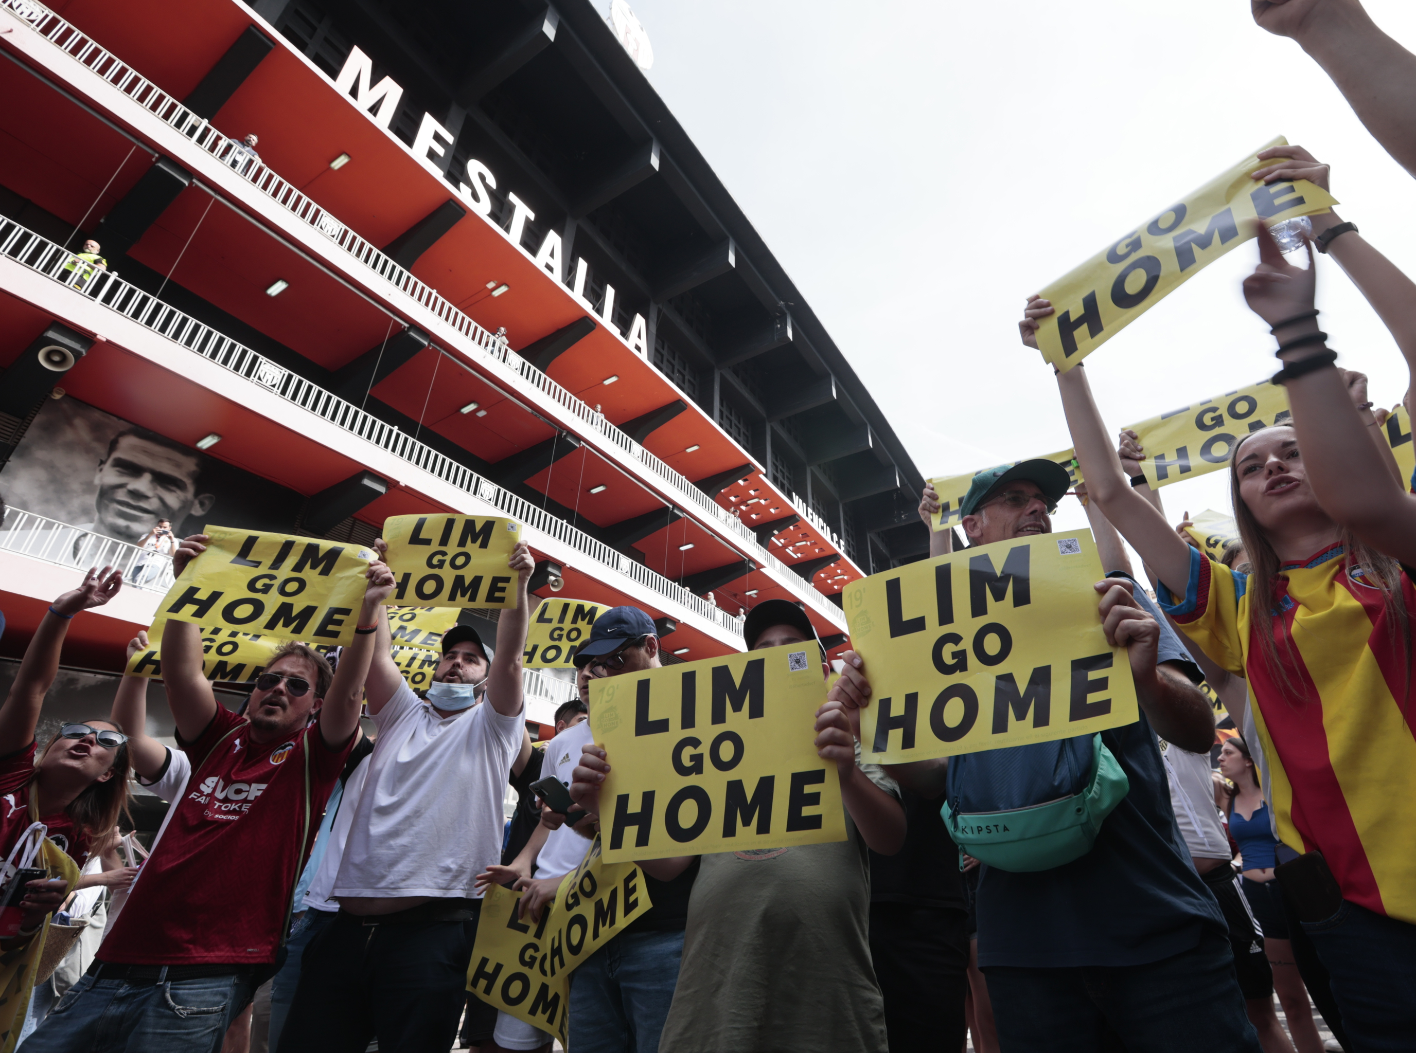
Managerial issues
Setting Clear Objectives and Transparency:
Define measurable goals for team performance and success, ensuring transparent communication with players, staff, and fans.
Balancing Data and Leadership Qualities:
Combine data insights with evaluations of leadership, community sentiment, and qualitative factors like team cohesion.
Ensuring Technical Preparation:
Invest in accurate data collection systems and advanced analytics tools, while providing staff training for effective adoption.
Phased Implementation for Smoothed Integration:
Introduce the analytics solution step by step, minimizing disruption to daily operations, with strong collaboration across teams.

Slide 7

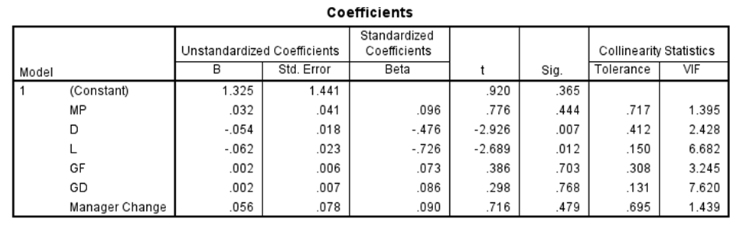
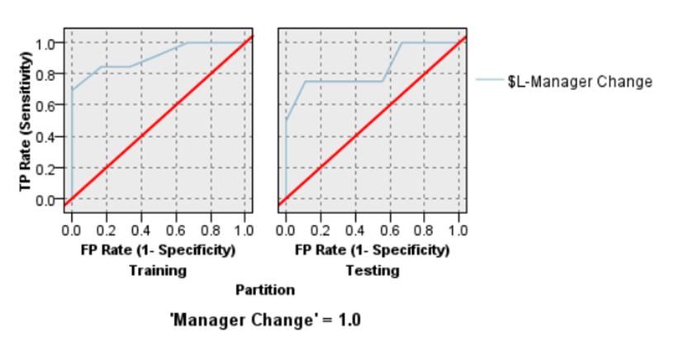
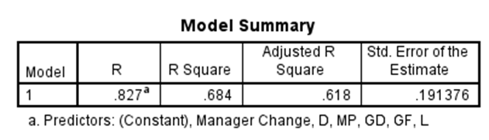
The business analytics solution
Through our development of 2 analytics models and 3 analytics methods we produced actionable insights to stakeholders
Linear Regression
Logistic Regression
Models showed dependability, accuracy and confidence
Overall reliable insights

Slide 8
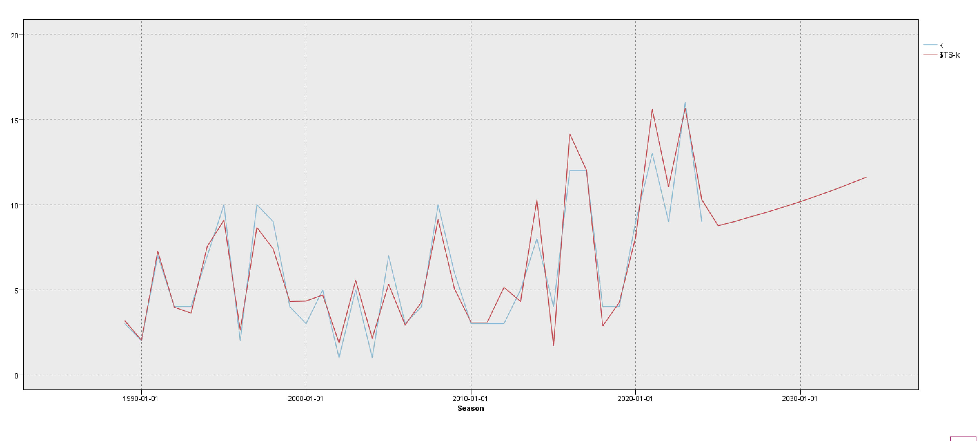
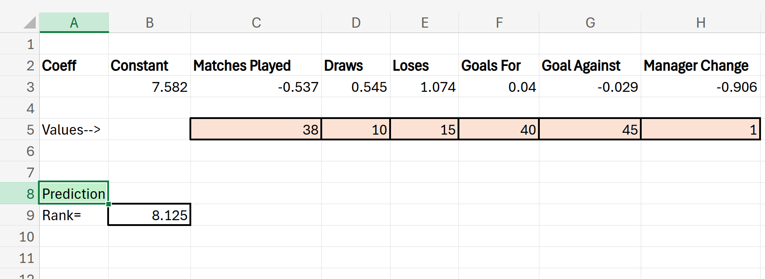
The business analytics solution
Time Series Analysis
Multiple Linear Regression
Prediction tool

Slide 9
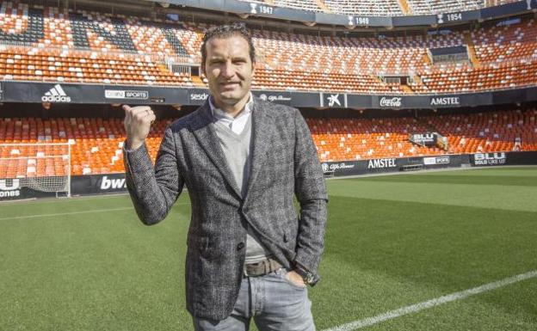
Recommendations
 | Pts/MP | $L-Manager Change | $LP-Manager Change | $LP-0 | $LP-1
2022-23 | 1.29 | 1 | 0.708 | 0.292 | 0.708
2018-19 | 1.61 | 1 | 0.839 | 0.161 | 0.839
2011-12 | 1.61 | 1 | 0.751 | 0.249 | 0.751
2008-09 | 1.87 | 0 | 0.657 | 0.657 | 0.343
Baraja will remain appointed under the parameters that he achieve a Pts/MP score after the season greater than 1.505
His position will be under review and a deadline to achieve this will be implemented. The actual date will be set at the discretion of the key stakeholders

Slide 10
References
Valencia CF. (2023, February 15). Baraja: For me, coaching Valencia CF is my lifelong dream. Valencia CF. https://www.valenciacf.com/en-baraja-for-me-coaching-valencia-cf-is-my-lifelong-dream-2023-02-15
Transfermarkt. (2024). Valencia CF performance data 2024. https://www.transfermarkt.com/valencia-cf/leistungsdaten/verein/1049/reldata/ES1%262024
Valencia CF. (2020, November 4). Dani Roca (Blinkfire Analytics): Valencia CF are a global benchmark in sponsor exposure on social networks. Valencia CF. https://www.valenciacf.com/en-dani-roca-blinkfire-analytics-valencia-cf-are-a-global-benchmark-in-sponsor-exposure-on-social-networks-2020-11-04
Valencia CF. (2021, June 10). Valencia CF and Zeus to collaborate on data analysis. Valencia CF. https://www.valenciacf.com/en-valencia-cf-and-zeus-to-collaborate-on-data-analysis-2021-06-10
La Source. (n.d.). Interview with Franco Segarra, innovation director at Valencia CF. La Source. https://www.lasource.io/news/interview-with-franco-segarra-innovation-director-at-valencia-cf
StatMuse. (n.d.). Valencia home records 2023/2024 season. StatMuse. https://www.statmuse.com/fc/ask?q=valencia+home+records+2023%2F2024+season

